Slide 1
Motion, Distance, Displacement and Equations of Motion
Submitted by Harshit Sinha and Ansh Vardhan

Slide 2
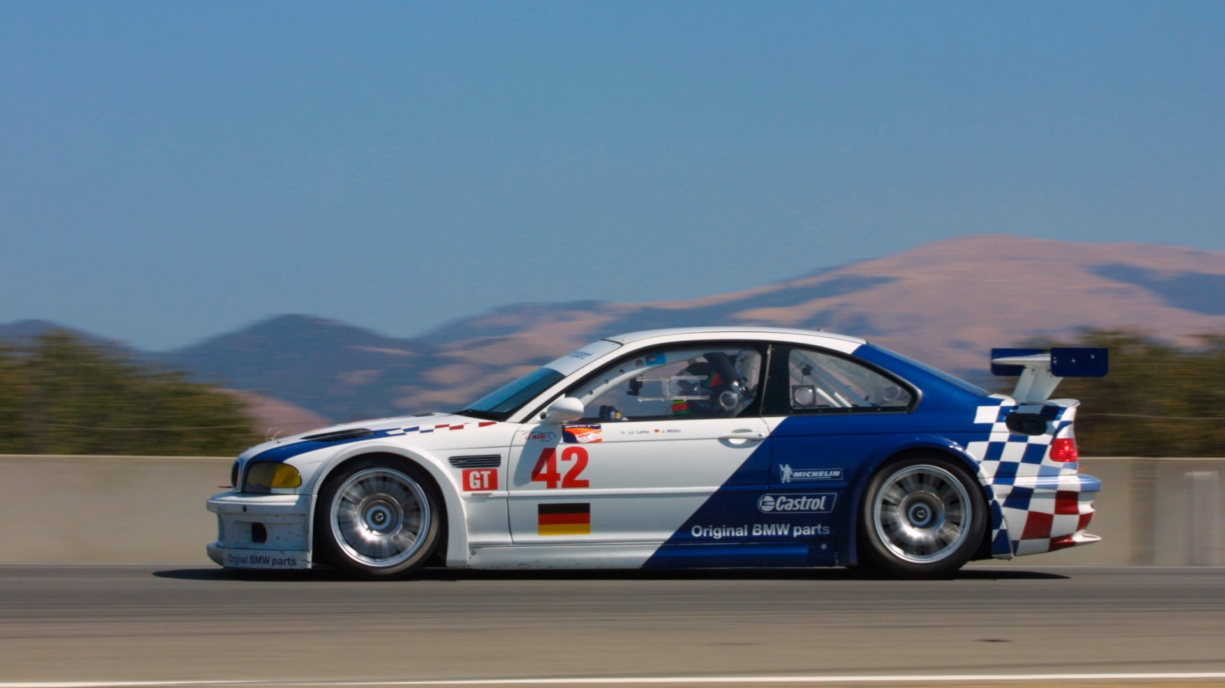
Motion is the change in the position of an object with time with respect to a reference point. Example: A car moving on a road is in motion because its position changes with time relative to the road.

Slide 3
Distance
Distance is the total length of the path travelled by an object.
Characteristics:
It is a scalar quantity (only magnitude).
It is always positive.
SI unit: metre (m).
Example:
If a student walks 100 m to school and then 50 m back,
Distance = 100 + 50 = 150 m

Slide 4
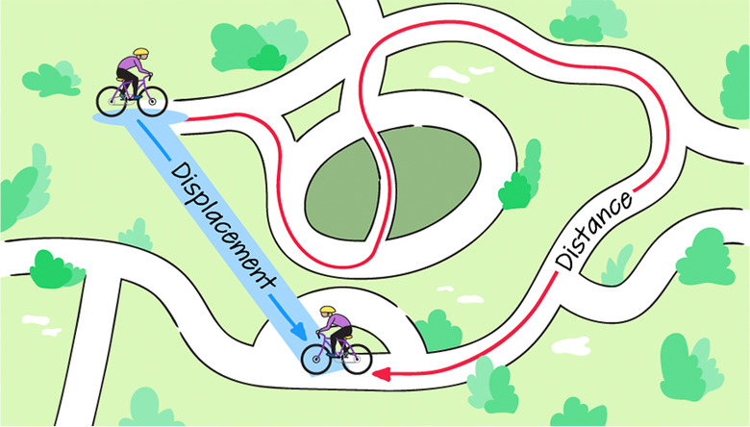
Displacement
Displacement is the shortest straight-line distance from the initial position to the final position, along with the direction.
Characteristics:
• It is a vector quantity (magnitude and direction).
• It can be positive, negative, or zero.
• SI unit: metre (m).

Slide 5
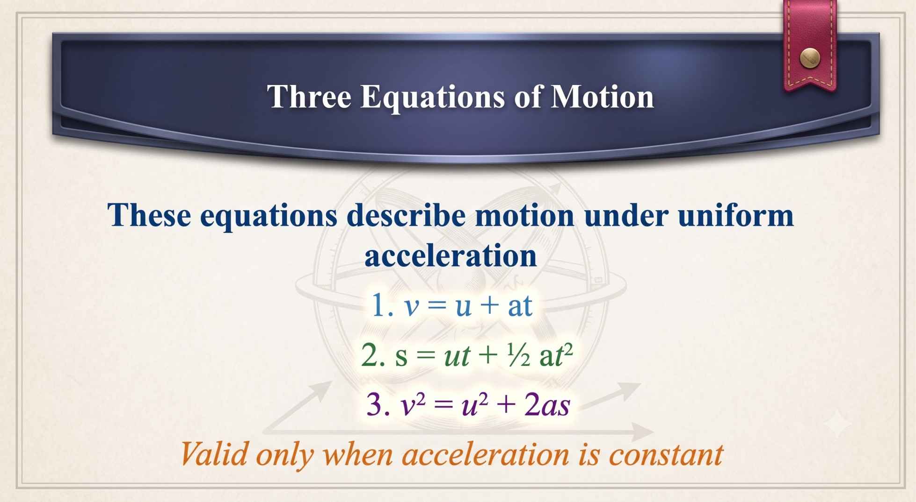

Slide 6
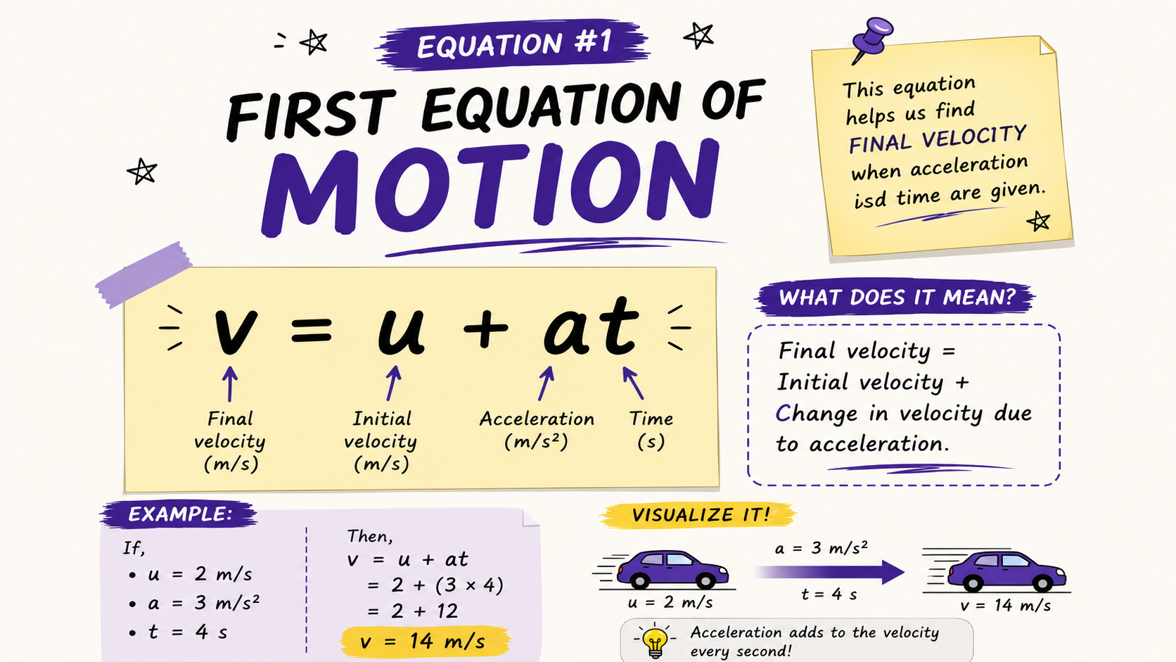

Slide 7
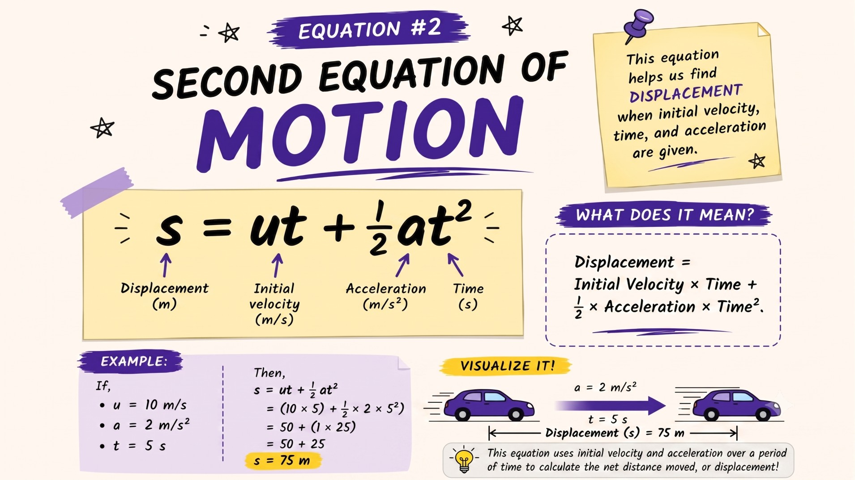

Slide 8
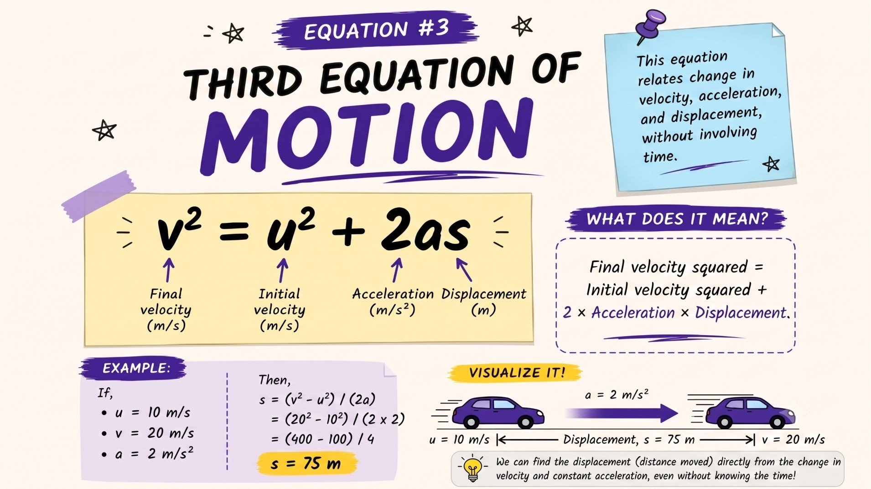

Slide 9
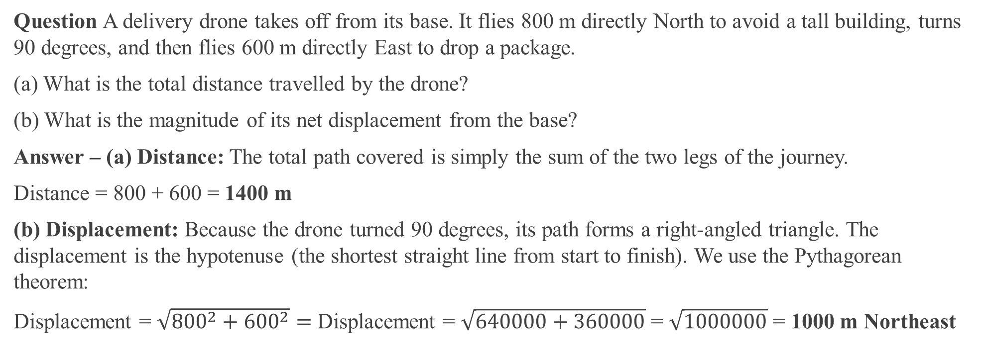
Competency-Based Questions (Class 9)
Question A delivery drone takes off from its base. It flies 800 m directly North to avoid a tall building, turns 90 degrees, and then flies 600 m directly East to drop a package.
(a) What is the total distance travelled by the drone?
(b) What is the magnitude of its net displacement from the base?
Answer – (a) Distance: The total path covered is simply the sum of the two legs of the journey.
Distance = 800 + 600 = 1400 m
(b) Displacement: Because the drone turned 90 degrees, its path forms a right-angled triangle. The displacement is the hypotenuse (the shortest straight line from start to finish). We use the Pythagorean theorem:
Displacement = $\sqrt{{800}^{2}+{600}^{2}}=$Displacement = $\sqrt{640000+360000}$ = $\sqrt{1000000}$ = 1000 m Northeast

Slide 10
Competency-Based Questions (Class 9)
Question: A child drops a bouncy rubber ball from a balcony exactly 20 meters above the concrete ground. The ball hits the ground, bounces straight back up to a peak height of 15 meters, falls back down, and is finally caught by a friend standing on the ground.
(a) Calculate the total distance the ball travelled through the air.
(b) What is the ball's final displacement relative to the balcony?
Answer: (a) Distance: We must track every leg of the ball's journey.
Fall 1: 20 m down >> Bounce 1: 15 m up >> Fall 2: 15 m down.
Total Distance = 20 + 15 + 15 = 50 m
(b) Displacement: Displacement is the shortest straight line from the initial position (balcony) to the final position (ground). The ball started 20 m high and ended on the ground (0 m). The upward and downward bounces in between do not matter. Displacement = 20 m downward

Slide 11


